Slide 1

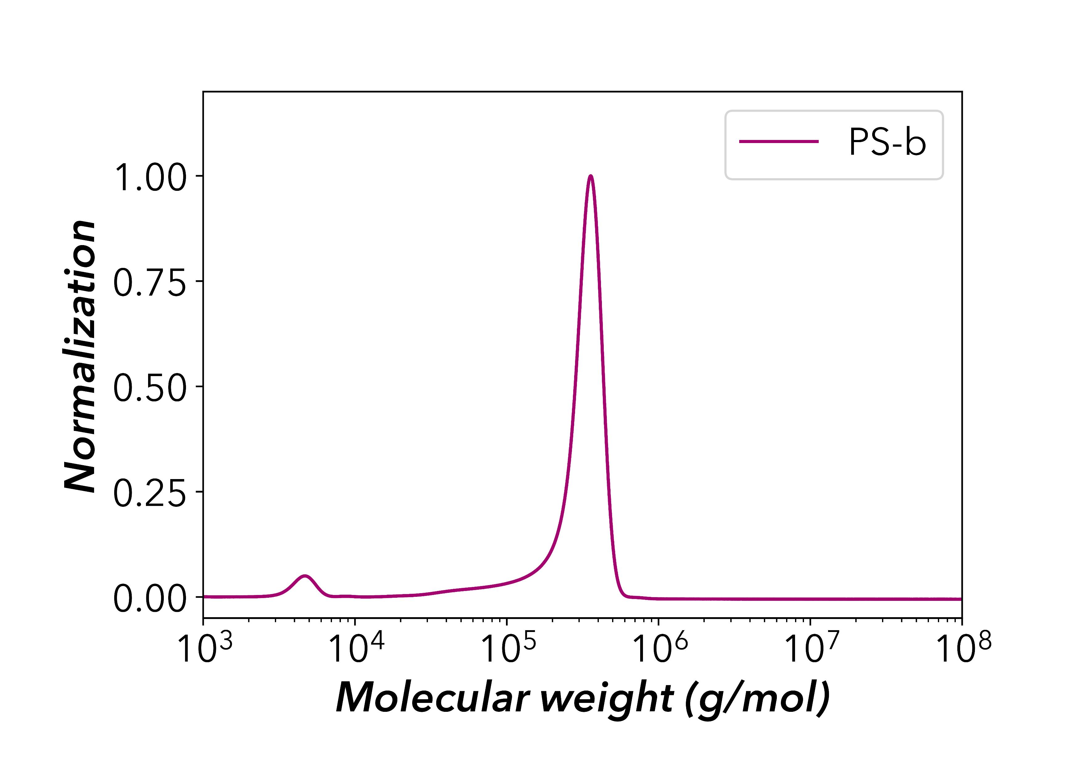
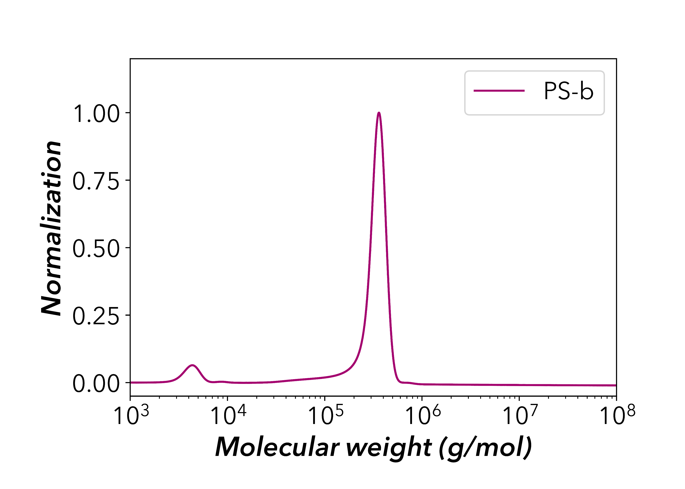




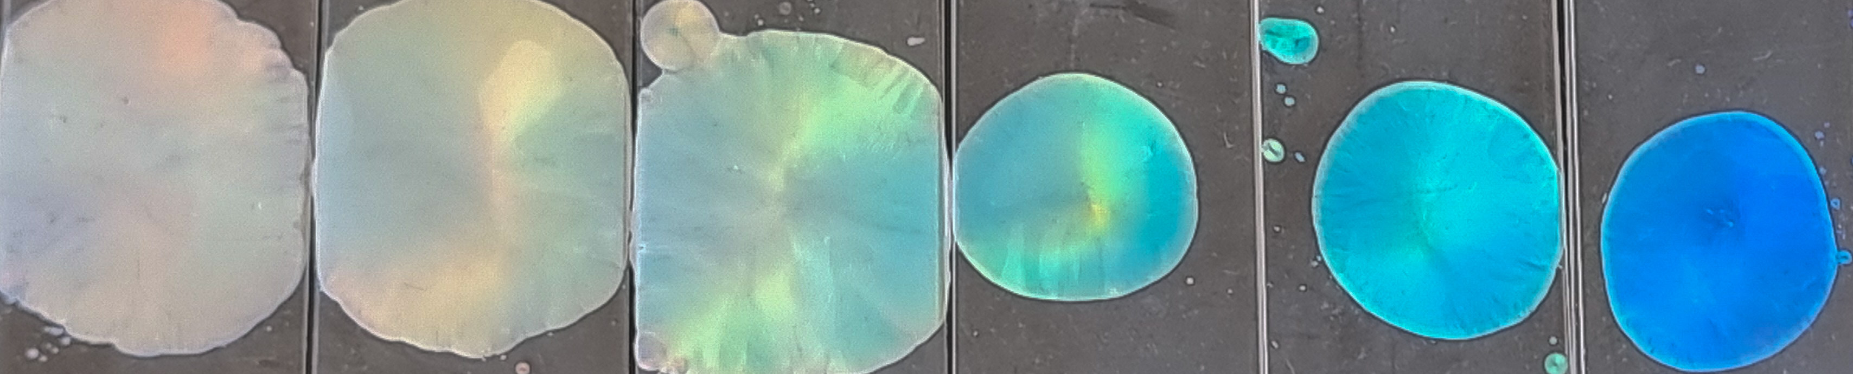
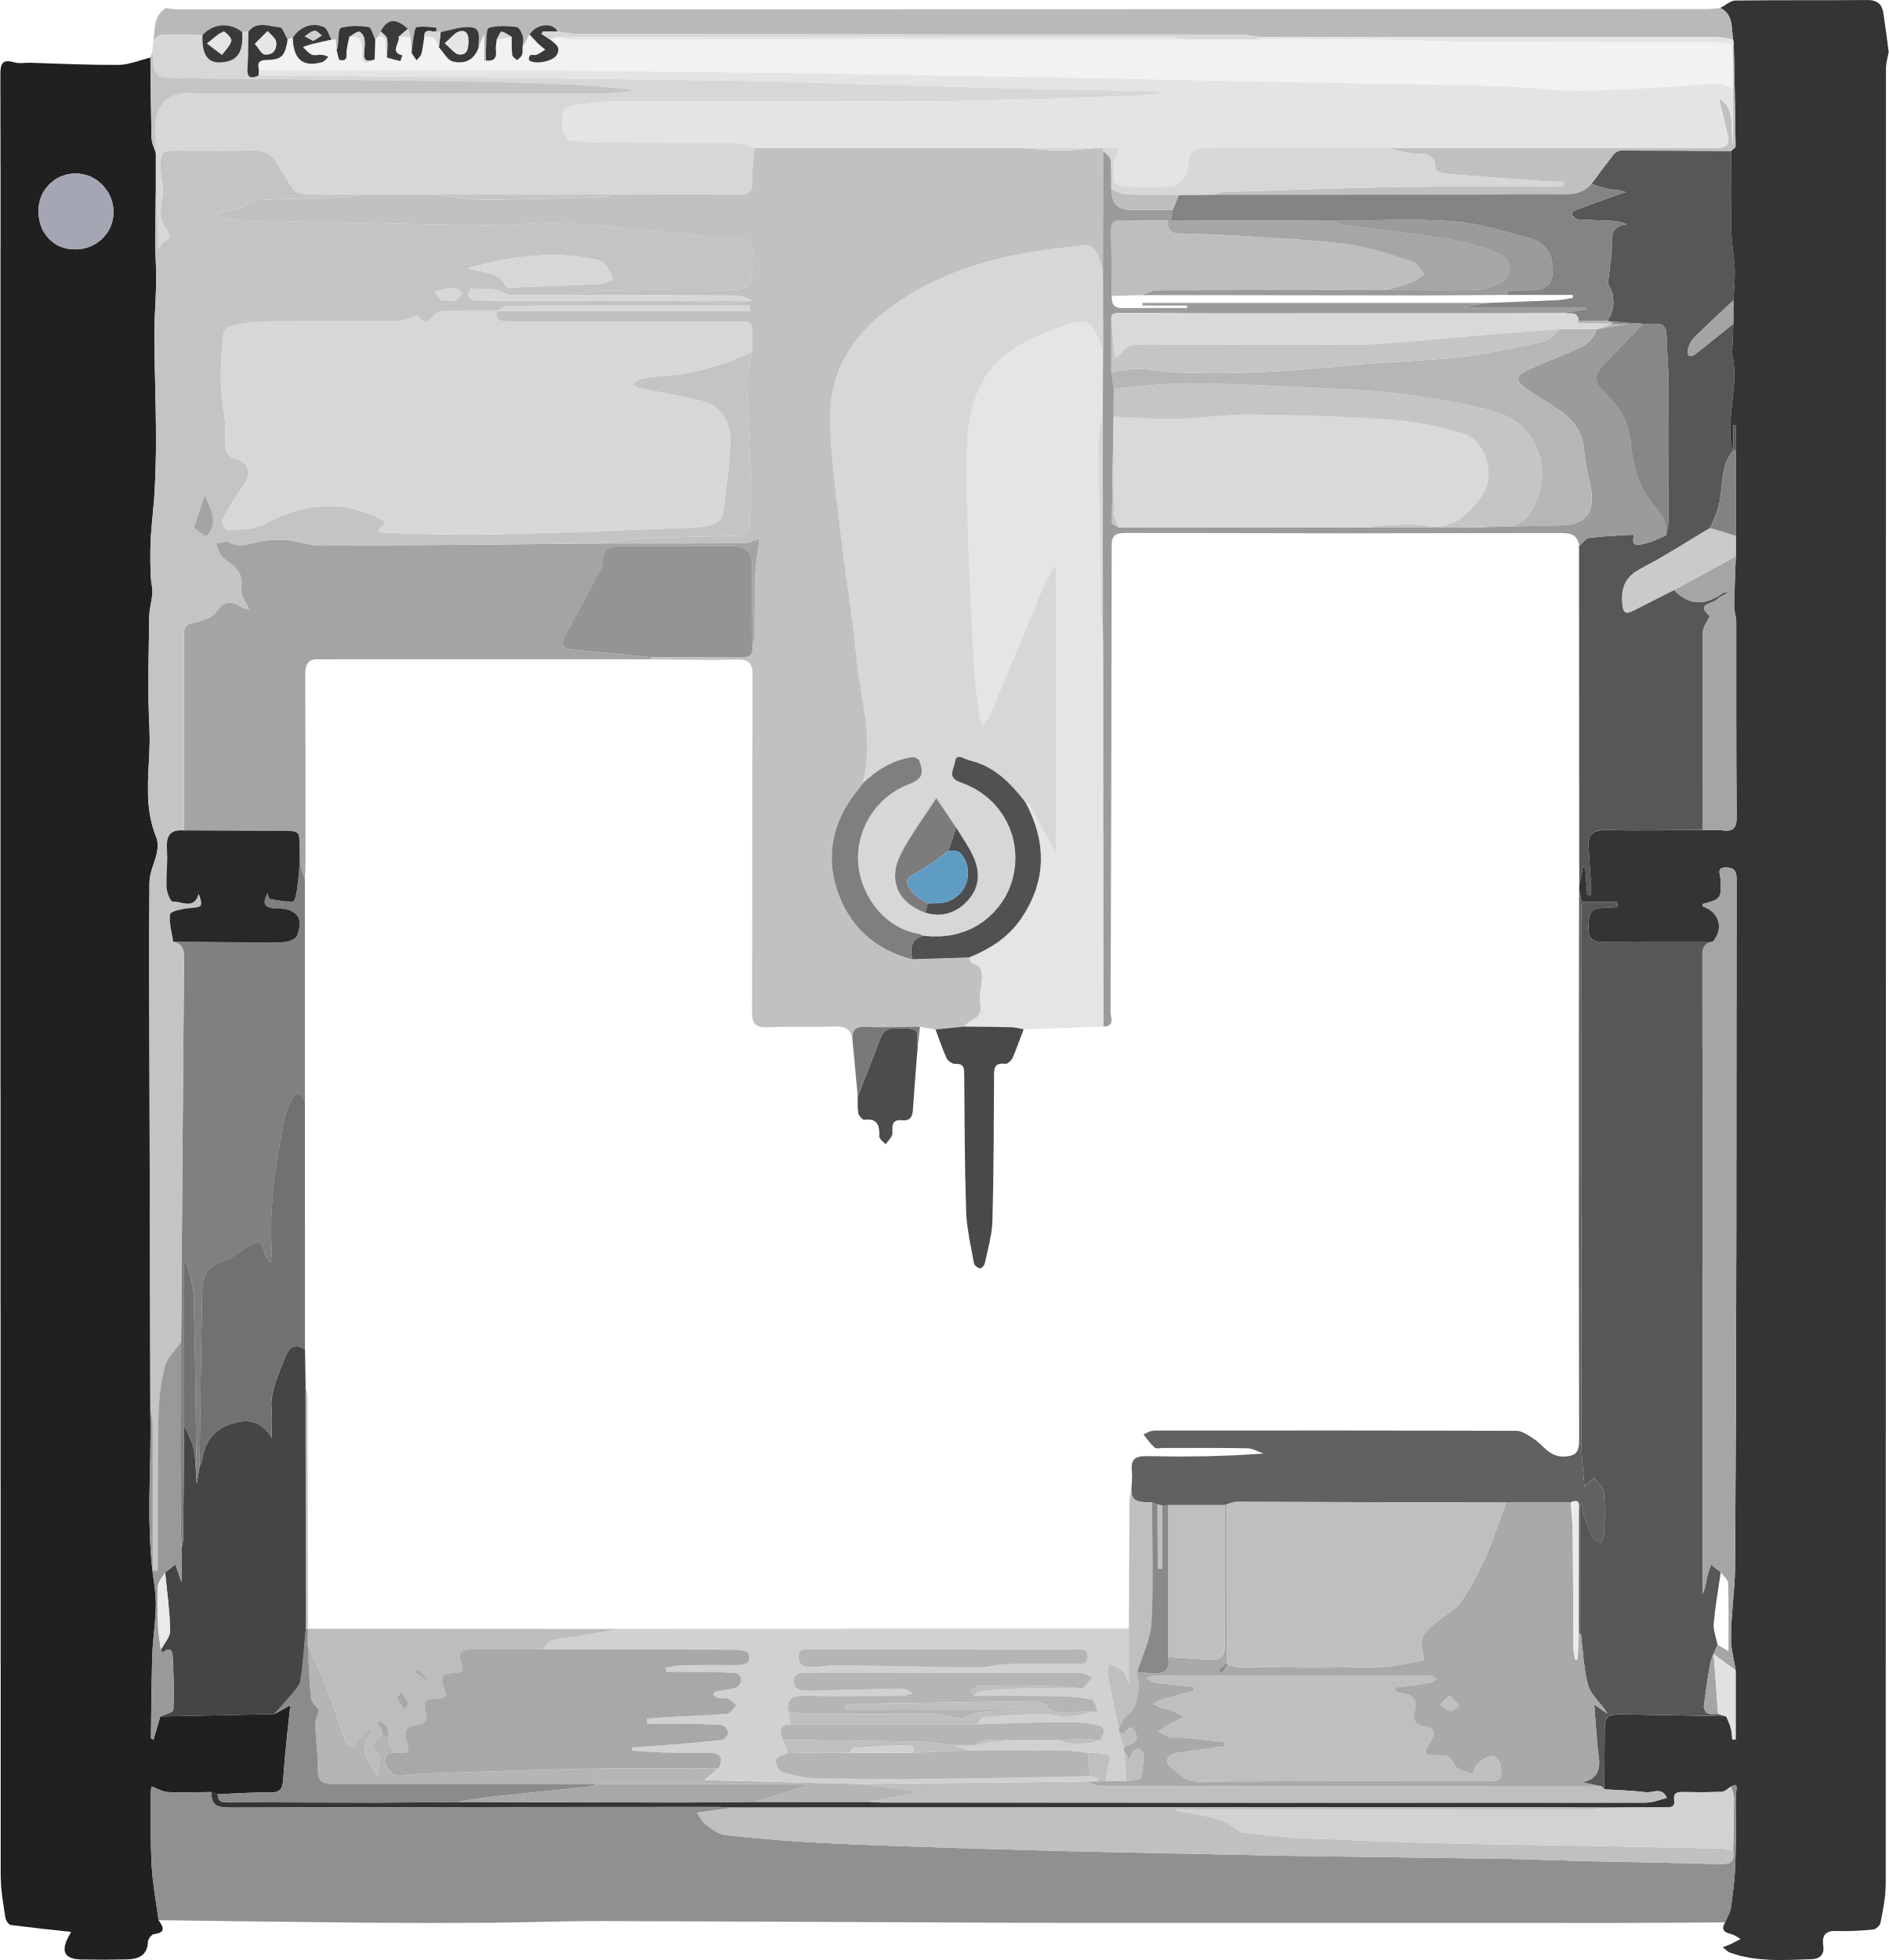
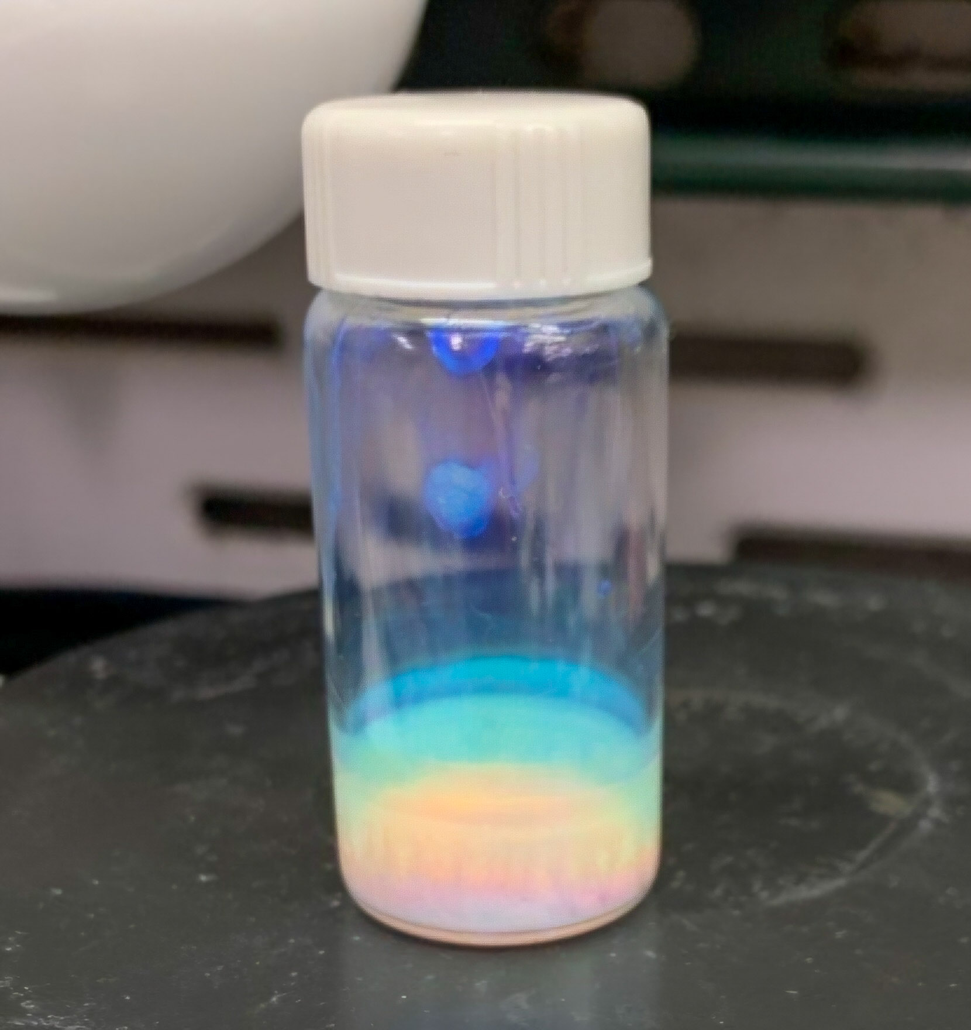

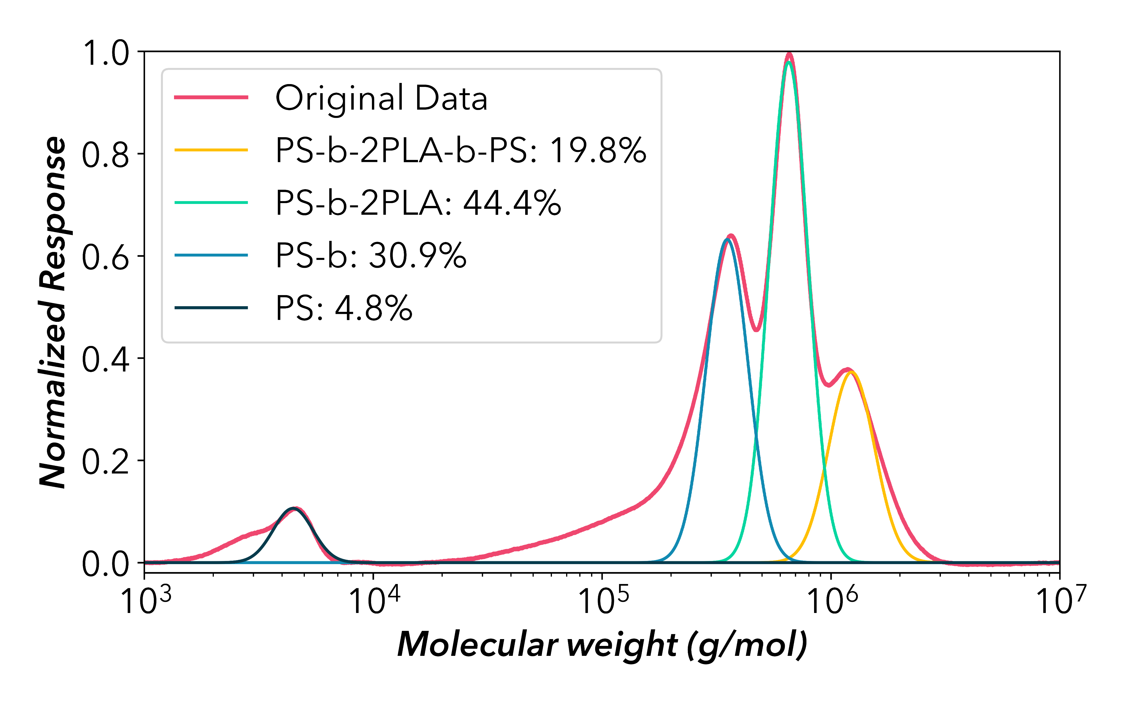
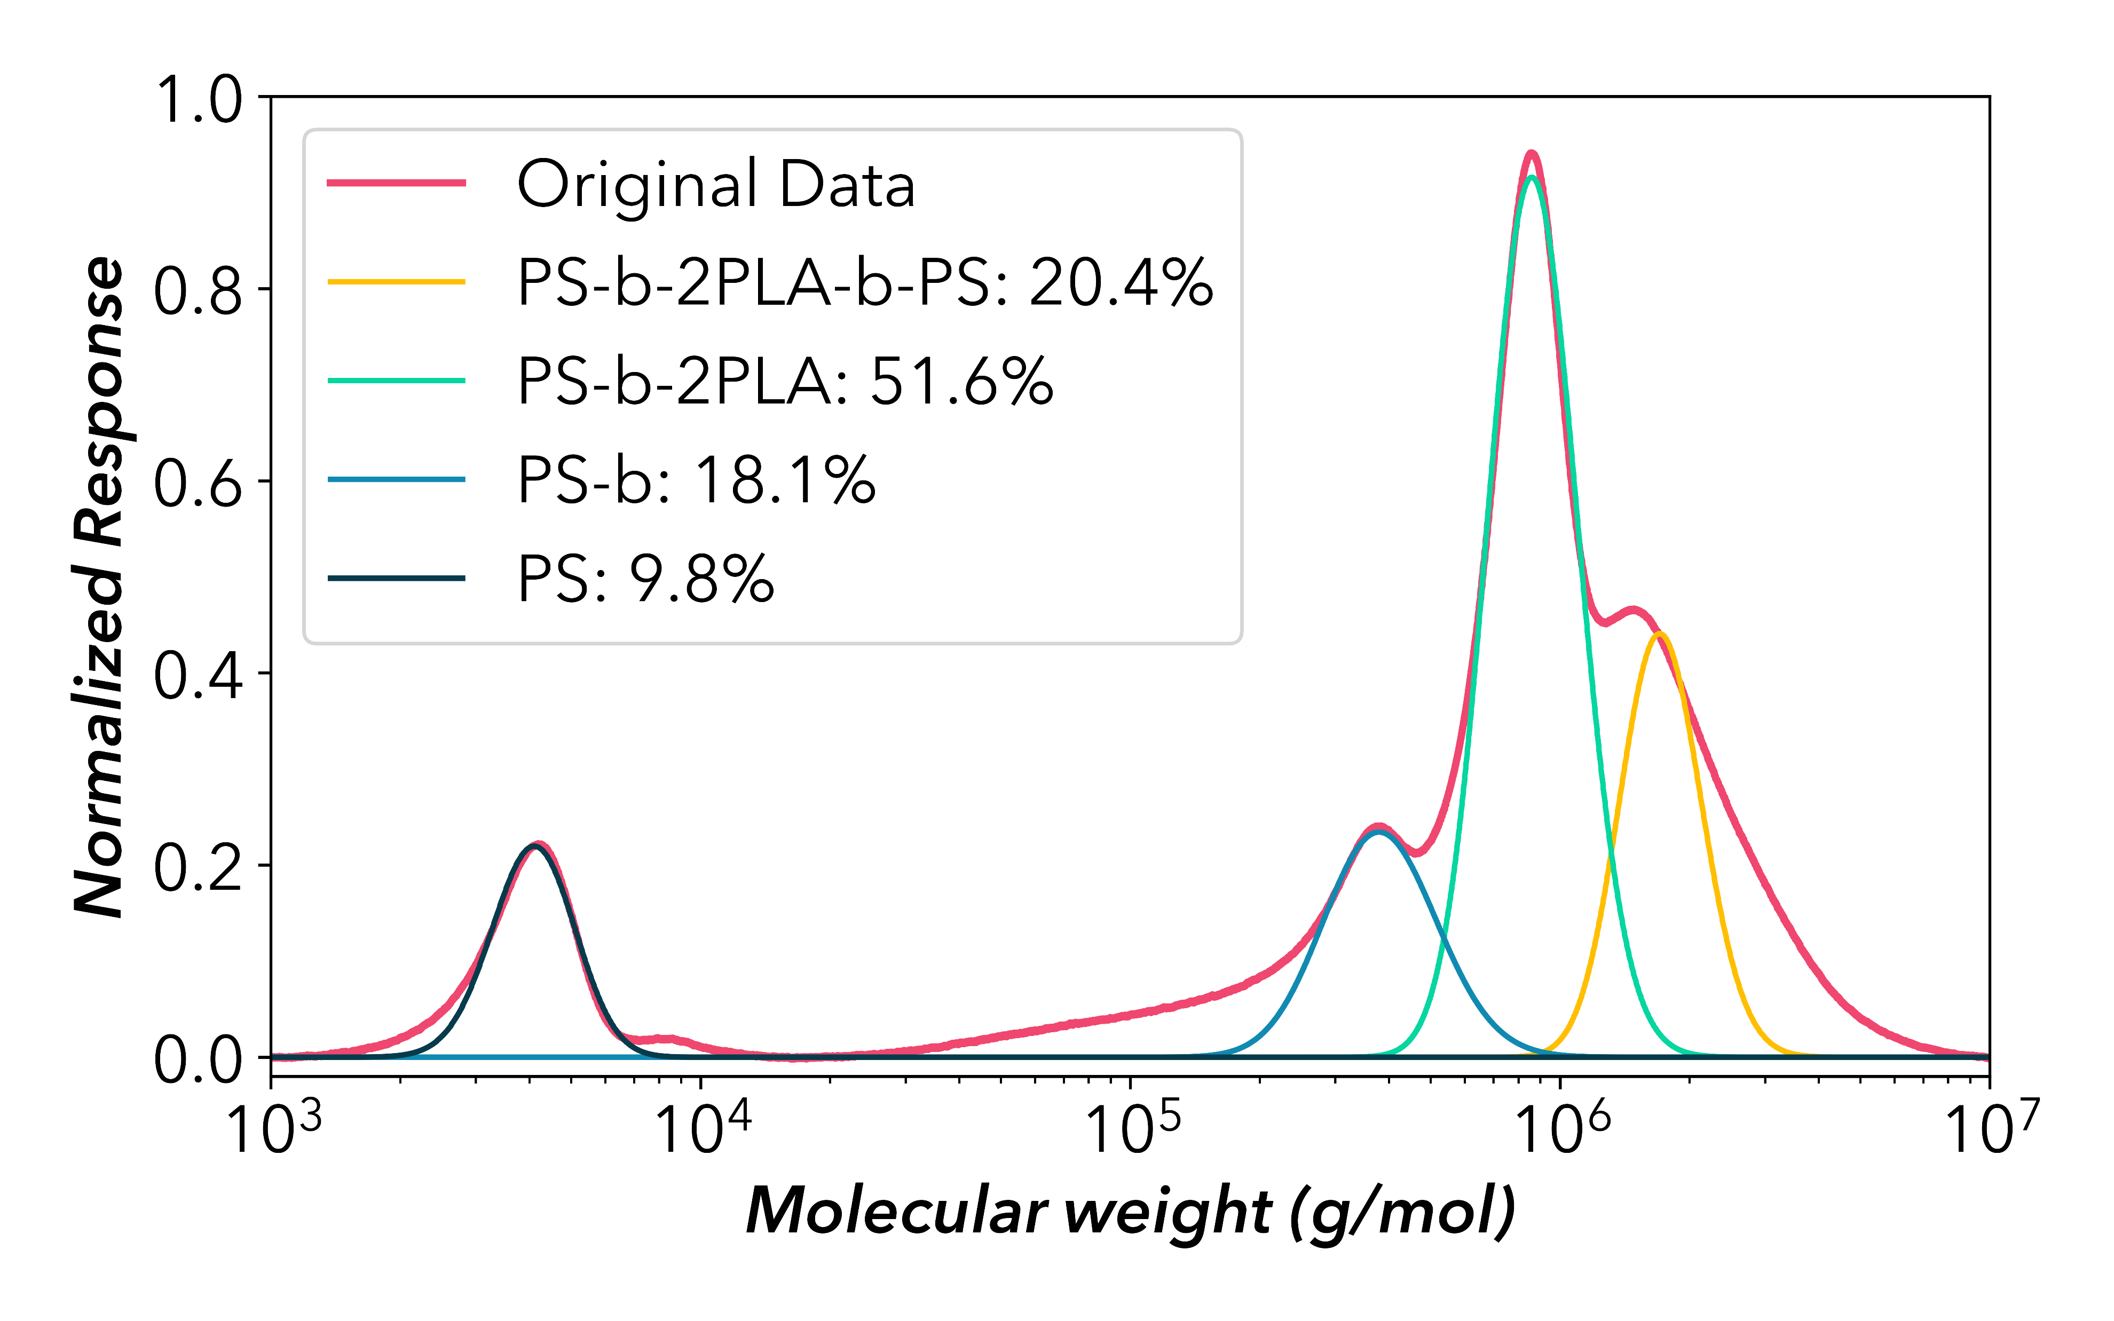




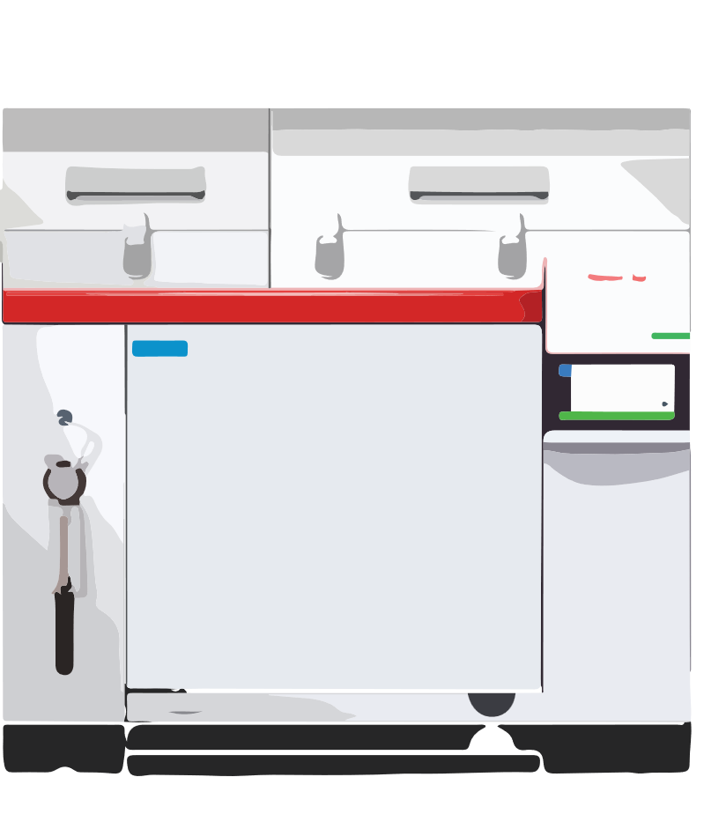

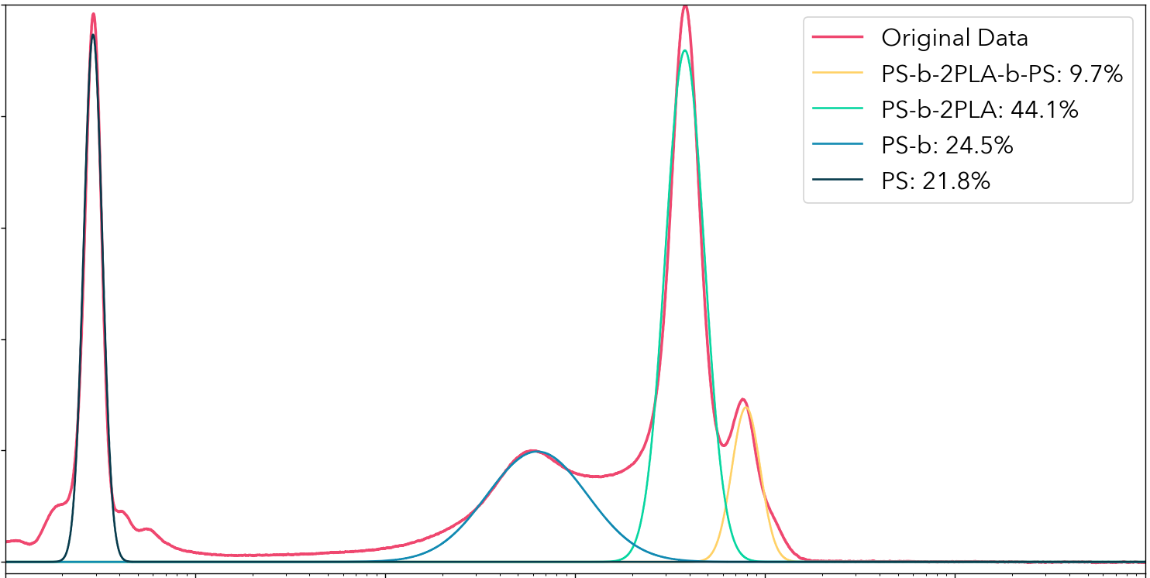

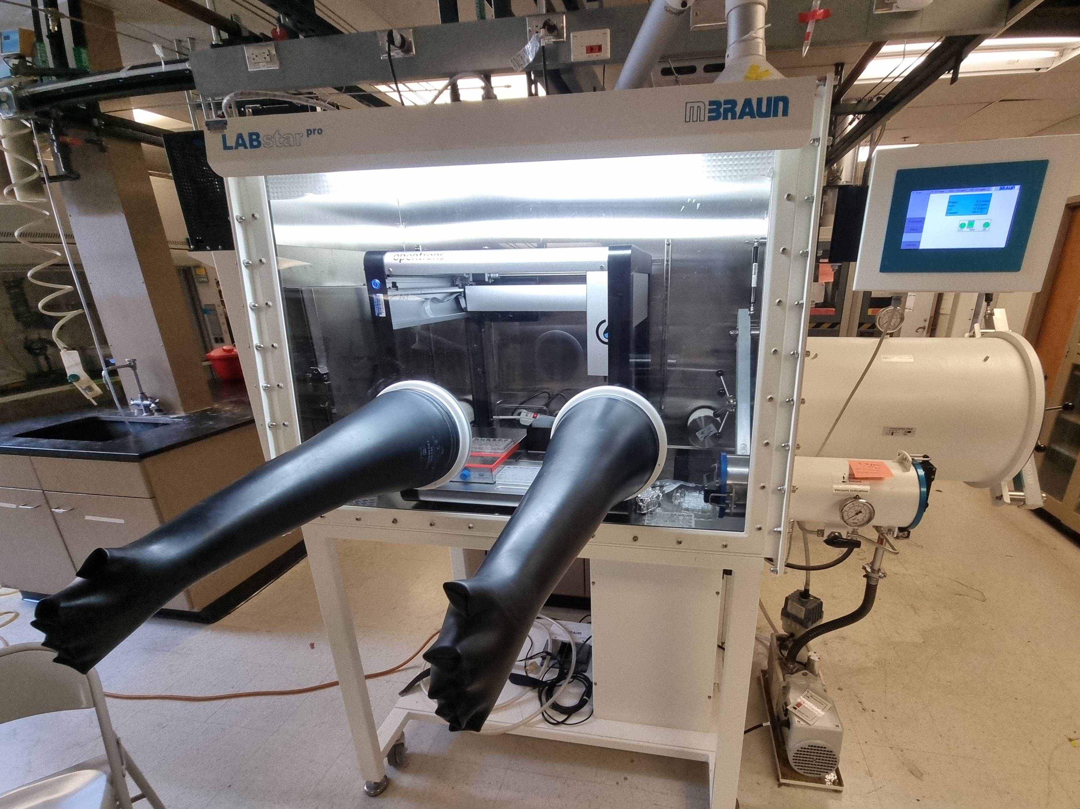
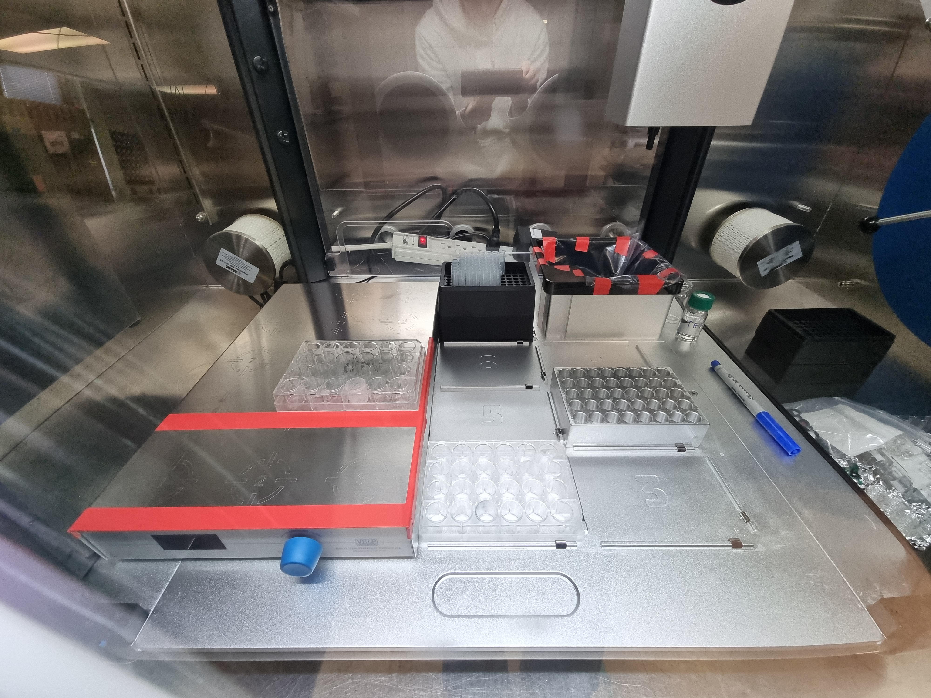
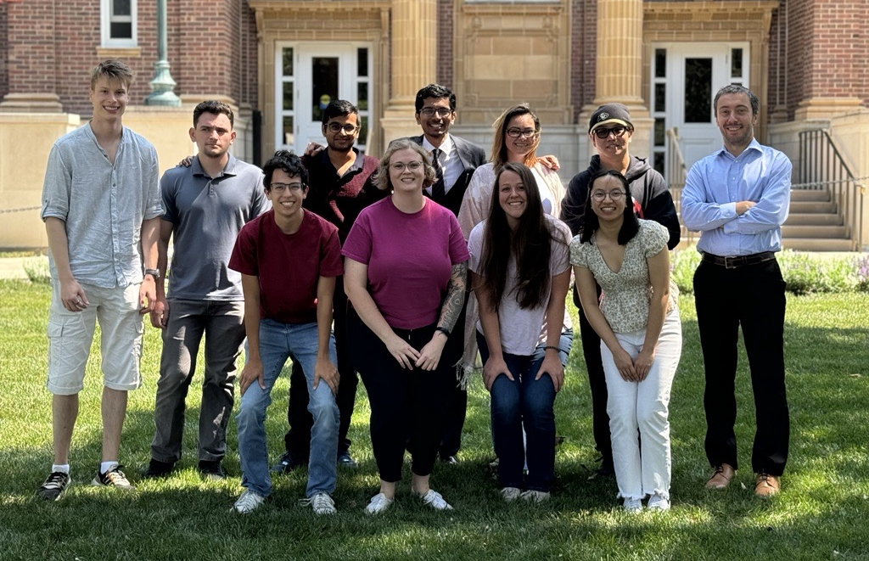

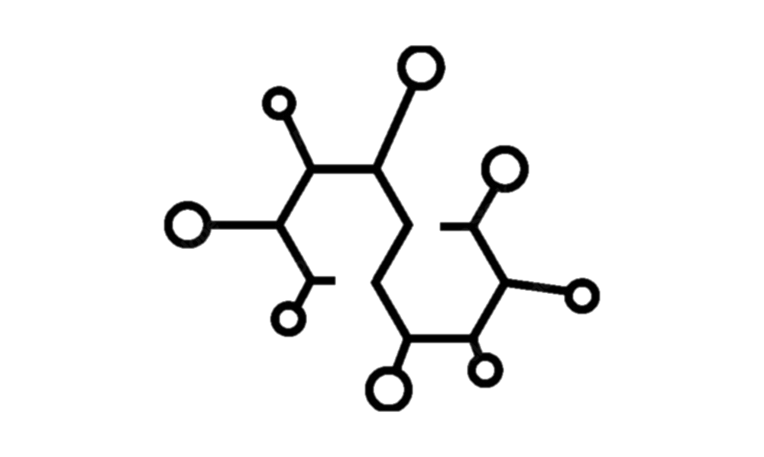



Accelerating Polymer Discovery with High-Throughput Automated Bottlebrush Block Copolymer Synthesis
Edgar Dobra, Damien Guironnet Department of Chemical and Biomolecular Engineering
Introduction
Methods
Results
What are bottlebrush block copolymers (BBCPs)?
Design of Experiments
COMPARISON OF THE PS-BBs
OT-2 PS-ROMP GPC
Brushes
Polystyrene block (PS)
Polymers: Large molecules composed of repeating monomer units, forming long chains¹
Block Copolymers: Polymers with two or more distinct monomer blocks linked together²
Bottlebrush Polymers (BBs): Macromolecules featuring a linear backbone with densely grafted polymeric side-chains³
Developing the polymer synthesis code in Python
Designing BBCP composition
Preparing the OT-2 for inert atmosphere polymerizations
 | PS-BB Control | PS-BB OT-2
Mn (g/mol) | 318000 | 333000
Đ | 1.04 | 1.05
DP | 74 | 78
Conv. (%) | 96.7 | 95.6
Glovebox Control PS-ROMP GPC
N_{brush}
Polylactide block (PLA)
PS Homopolymer
PS-BB
PS Homopolymer
PS-BB
Backbone
Experimental Data
N_{block1}
N_{block2}
Low-dispersity, high molecular weight BB peaks with high conversions
Bottlebrush block co-polymers (BBCPs)
Films with BBCP photonics
Polymer Synthesis
Anionic Polymerization of Styrene
Similar sharp peaks → Control experiment reproducible
(1) Young, R. J.; Lovell, P. A. Introduction to Polymers; CRC Press, 2011. | (2) Noshay, A.; McGrath, J. E. Block Copolymers; Elsevier, 2013. (3) Verduzco, R.; Li, X.; Pesek, S. L.; Stein, G. E. Structure, Function, Self-Assembly, and Applications of Bottlebrush Copolymers. Chemical Society Reviews 2015, 44 (8), 2405–2420.
OT-2
COMPARISON OF THE PS-b-2PLAs
SYNTHESIS AND HIGH THROUGHPUT
Ring Opening Metathesis Polymerization Followed by Graft From
Similar peaks
Higher molecular weight on OT-2 can be due to slightly different loading
Glovebox Control ROMP-GRAFT GPC
OT-2 ROMP-GRAFT GPC
Goal:
Accelerate synthesis to speed up discoveries
Problems:
Chemistry is air- and moisture-sensitive⁴
Synthesis can be complex and tedious⁵
G3 in Toluene
Diblock PS-b-2PLA
Triblock PS-b-2PLA-b-PS
Diblock PS-b-2PLA
Triblock PS-b-2PLA-b-PS
DBU
Polymerizations
PS macromonomer in THF
PS Homopolymer
PS Homopolymer
Lactide in THF
exo Norbonene n-methanol in THF
PS-BB
PS-BB
3rd Gen. Grubbs Catalyst (G3)
Dried out BBCP
PS-b-2PLA
Boric acid in THF
Tri(ethylene glycol) divinyl ether
Successful automation of BBCP synthesis
DP_{S} (styrene) | 20, 30, 40
DP_{PS} (polystyrene) | 20 → 400
DP_{LA} (lactic acid) | 20 → 50
DP_{PLA} (polylactic acid) | 20 → 400
DP_{n(PLA)} (PLA chains) | 1, 2, 5
DBU in THF
Change in the size of the first and second block (DP_{PS}, DP_{PLA})
Polymer Characterization
Composition based on weight* | PS Homopolymer | BB PS | Diblock PS-b-2PLA | Triblock PS-b-2PLA-b-PS
Control (%) | 4.7 | 31.0 | 44.5 | 19.8
OT-2 (%) | 9.8 | 18.1 | 51.6 | 20.4
Polymers are characterized by Gel Permeation Chromatography (GPC) based on their Molecular Weight
Calculated Composition Data
Variable Parameters
*Assuming polymers have similar sample constants for GPC intensity
Change in the size of the brush length (DP_{S}, DP_{LA})
96 x Pipette Tips
192 x Pipette Tips
BBCPs with various compositions need to be synthesized and characterized
GPC
Gel Permeation Chromatography
MAXIMUM CAPABILITIES
Synthetic capabilities are highly dependent on what the machine does
Ability to run up to 112 reactions simultaneously
80 x 1.5mL GPC
Trash Container
Trash Container
Change the grafting density of PLA (DP_{n(PLA)})
Data Analysis
Analyze data via Python scripts
Plot GPC graphs
Determine composition by fitting Gaussians to different polymer peaks on GPC data
2 x 100mL Beaker
112 x 4mL Vials
6 x 100mL Beaker
(4) Jawiczuk, M.; Marczyk, A.; Trzaskowski, B. Decomposition of Ruthenium Olefin Metathesis Catalyst. Catalysts 2020, 10 (8), 887. | (5) Kamble, Y. L.; Shi, J.; Jeon, S.; Diao, Y.; Rogers, S.; Guironnet, D. Synthesis and Characterization of High-Density and High Degree of Polymerization Bottlebrush Block Copolymers for Photonic Applications. Macromolecules 2025, 58 (6), 3006–3015.
56 x 4mL Vials
45 x 15mL Falcon
AUTOMATION WITH OT-2 (OPENTRONS)
Pipette
12 x 20mL Vials
400mL Beaker
12 x 20mL Vials
400mL Beaker
4mL Vial Holder
Pipette Tips
Deconvolution and Analysis Using Python
With precipitation and GPC ✔
45 x 200mg (5g) polymer, precipitation in 15mL Falcon (3x excess)
18 x 200mg (3.6g) polymer, precipitation in 50mL Falcon (15x excess)
Without precipitation nor GPC ✘
112 x 200mg (22.4g) polymer, reaction in 4mL Vials
48 x 1g (3.6g) polymer, reaction in 20mL Vials
Glovebox w/ OT-2
96 x Pipette Tips
Multi-Zone Stir Plate
GPC Vial Holder
Trash Container
Future Work
Acknowledgments
Multi-Zone Stir Plate
40 x 1.5mL GPC
A glovebox allows handling of air- or moisture-sensitive chemistry⁶
A liquid handler enables precise control over BBCP composition
Automated protocols facilitate conducting experiments in series efficiently
STRESS TESTING SYSTEM UNDER HIGH LOADS
EXTENDING TO DIFFERENT CHEMISTRIES
12 x 20mL Vials
2 x 100mL Beaker
15 x 15mL Falcon
OT-2
Testing system to create 50-100 different polymers simultaneously
Gram scale experiments
Produce films for photonics
Experimenting with the compatibility of the system with other air- and moisture-sensitive polymer chemistries
Extending our polymer toolbox with the help of automation
28 x 4mL Vials
400mL Beaker
6 x 50mL Falcon
(6) Muhr, M.; Heiß, P.; Schütz, M.; Bühler, R.; Gemel, C.; Linden, M. H.; H. Bernhard Linden; Fischer, R. A. Enabling LIFDI-MS Measurements of Highly Air Sensitive Organometallic Compounds: A Combined MS/Glovebox Technique. Dalton Transactions 2021, 50 (26), 9031–9036.
Guironnet Group
Equipment inside OT-2

